Slide 1
Offline Handwritten Yoruba Character Recognition using Convolutional Neural Networks
By Samuel Ojumah (10CG011029)
Supervisor: Professor Sanjay Misra MSc Project Defence

Slide 2
Outline
Introduction
Literature Review
Related Works
Statement of the Problem
Aim and Objectives

Slide 3
Outline
Methodology
Results
Significance of the Study
Contribution to Knowledge
Conclusion
References
Acknowledgement

Slide 4
Introduction
Deep learning is one of the foremost trends in computing today that has led to state-of-the-art results in image recognition, speech recognition and natural language processing.
By developing deep architectures, neural networks have been able to out-perform other algorithms in recognizing and classifying objects in images.

Slide 5
Introduction cont.
Character recognition is one of the many domains of image recognition. Two types of character recognition systems:
Online and Offline recognition (Ajao et al., 2014)
Online: recognizes character patterns captured from a pen-based or touch-based input device
Offline: recognizes character patterns captured from a scanner or a camera device as two dimensional images

Slide 6

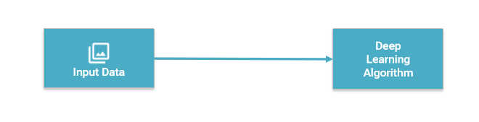
Introduction cont.
Deep learning architectures
Figure 1: Traditional machine-learning architecture and deep learning architecture
Source: http://www.slideshare.net/LuMa921/deep-learning-the-past-present-and-future-of-artificial-intelligence

Slide 7
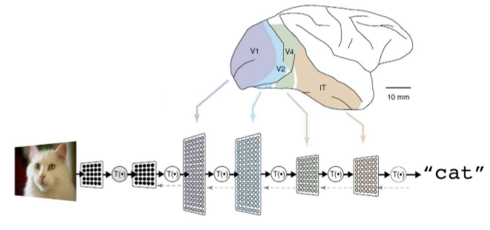
Deep Learning - Architecture
A deep neural network consists of a hierarchy of layers, whereby each layer transforms the input data into more abstract representations (e.g. edge -> nose -> face). The output layer combines those features to make predictions.
Figure 2: A deep neural network architecture for recognizing a cat photo
Source: https://cloud.google.com/blog/big-data/2016/07/understanding-neural-networks-with-tensorflow-playground

Slide 8
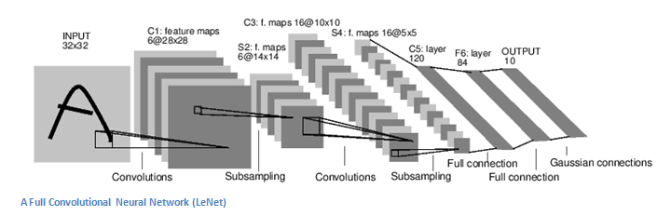
Convolutional Neural Networks
A Convolutional Neural Network (ConvNet) consists of several layers which can be of three types: convolutional, pooling and full-connected layers.
Figure 3: A convolutional neural network architecture (LeNet)
Source: https://culurciello.github.io/tech/2016/06/04/nets.html

Slide 9
Literature Review

Slide 10
Deep Learning Overview
YEAR | CONTRIBUTOR | CONTRIBUTION
300 BC | Aristotle | Associationism - started the history of man’s attempt to understand the brain.
1873 | Alexander Bain | Neural Groupings, the earliest models of neural network which inspired the Hebbian Learning Rule
1943 | McCulloch & Pitts | MCP Model, considered the ancestor of Artificial Neural Model.
1949 | Donald Hebb | Father of neural networks. Hebbian Learning Rule
Notes:
MCP – McCulloch Pitts Model

Slide 11
Deep Learning Overview cont.
YEAR | CONTRIBUTOR | CONTRIBUTION
1986 | Michael I. Jordan | Recurrent Neural Networks
1990 | Yann LeCun | LeNet – Proved the feasibility of deep neural networks in practice
1997 | (Hochreiter & Schmidhuber, 1997) | Long short-term memory (LSTM) and solved the problem of vanishing gradient in recurrent neural networks

Slide 12
Deep Learning Overview cont.
YEAR | CONTRIBUTOR | CONTRIBUTION
2006 | Geoffrey Hinton (Hinton, Osindero, & Teh, 2006) | Deep Belief Networks, also introduced layer-wise pre-training technique, opened current deep learning era.
2009 | (Salakhutdinov & Hinton, 2009) | Deep Boltzmann Machines
2012 | (Srivastava et al., 2014) | Dropout - an efficient way of training neural networks
Table 1: Brief history of deep learning
Source: (Wang, Raj, & Xing, 2017)

Slide 13
Literature Review cont.
AlexNet (2012)
Trained the network on ImageNet data, which contained over 15 million annotated images from a total of over 22,000 categories.
Used Rectified Linear Units (ReLU) for the nonlinearity functions (Found to decrease training time as ReLUs are several times faster than the conventional tanh function).
Trained on two GTX 580 GPUs for five to six days.

Slide 14
Literature Review cont.
ZF Net (2013)
Very similar architecture to AlexNet, except for a few minor modifications. AlexNet trained on 15 million images, while ZF Net trained on only 1.3 million images.
Used ReLUs for their activation functions, cross-entropy loss for the error function, and trained using batch stochastic gradient descent.
Trained on a GTX 580 GPU for twelve days.

Slide 15
Literature Review cont.
GoogLenet (2015)
Used 9 Inception modules in the whole architecture, with over 100 layers in total!
Uses 12x fewer parameters than AlexNet.
Trained on a few high-end GPUs within a week.

Slide 16
Literature Review cont.
Microsoft ResNet (2015)
52 layers
Trained on an 8 GPU machine for two to three weeks.
3.6% error rate
The ResNet model is the best CNN architecture that we currently have and is a great innovation for the idea of residual learning.

Slide 17
Literature Review cont.
Raina et al. (2014) suggested that GPU’s could operate at speeds up to 70 times faster than the CPU counterparts and increasingly realized that making use of lots of training data and of fast computation had been greatly undervalued in favor of incremental changes in learning algorithms.

Slide 18
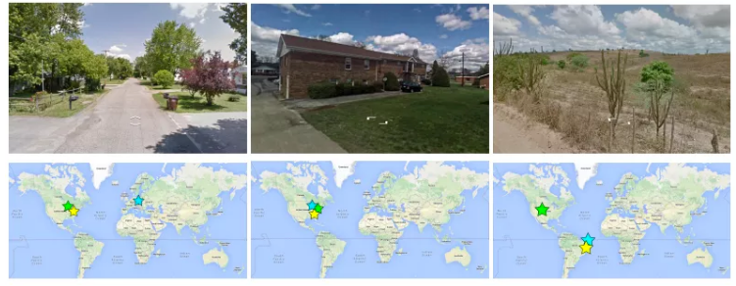
Literature Review cont.
Weyand et al. (2016) introduced PlaNet which takes a Photo and gives the exact location on the earth.
Figure 4: Images from PlaNet with exact locations of places on earth.
Source: Weyand et al. (2016)

Slide 19


Deep Learning frameworks
Caffe - (Jia et al., 2014)
MatConvNet - (Vedaldi and Lenc, 2015)
Theano – (Al-Rfou et al., 2016)
Tensorflow- (Abadi et al., 2016)

Slide 20
Related Works

Slide 21
Related Works
Handwritten English character recognition using neural networks (Patil & Shimpi, 2011)
Used neural networks with back-propagation for English characters
Achieved recognition rates of 70%
Online and offline handwritten Chinese character recognition: Benchmarking on new databases (Lui et al., 2013)
Achieved recognition rates of 94.85% with less samples.

Slide 22
Related Works cont.
Offline handwritten English character recognition based on convolutional neural network (Yuan, Bai, Jiao, & Liu, 2012).
Recognition rates of 93.7& and 90.2% were returned on the UNIPEN lowercase ad uppercase datasets respectively
Convolutional neural networks for the recognition of Malayalam characters (Anil, Manjusha, Kumar, & Soman, 2015).
Performance jump from 75% to 92% is achieved after grouping and a multi-class support vector machine used for inner level classification yields an accuracy range of 99-100%.

Slide 23
Related Works cont.
Deep Learning in Character Recognition Considering Pattern Invariance Constraints (Oyedotun & Olaniyi, 2015)
Used only Yoruba vowels for experiments.
Hidden Markov Model Approach for Oﬄine Yoruba Handwritten Word Recognition (Ajao et al., 2016) used HMM’s for Yoruba characters.
Achieved recognition rates of 95.6%
Data was limited to Yoruba medical pathology words.

Slide 24
Related Works cont.
Zhang et al. (2017) in Online and offline handwritten Chinese character recognition: A comprehensive study and new benchmark integrated traditional normalization-cooperated direction-decomposed feature map (directMap) with the deep convolutional neural network (convNet).
Achieved the best recognition rates of HCCR.
Golovko, Egor, Brich, & Sachenko (2017) in A shallow convolutional neural network for accurate handwritten digits classification
The network obtained a test error rate of 0.71% on the standard MNIST handwritten dataset with less computational resources being consumed.

Slide 25
Review Summary
Convolutional neural network architectures have been applied to identify characters of several languages.
They have been shown to achieve test error rates below 0.4% as seen on the MNIST database (Golovko et al., 2017).
However, there is no existing model for Yoruba characters.
This study therefore is geared towards developing a ConvNet model for Yoruba characters.

Slide 26
Statement of the problem
Extracting textual information from natural images is a challenging problem with many practical applications (Wang et al., 2012)
CNN’s have been applied to OCR systems for English, Chinese, French and other languages but have not been applied to Yoruba characters.

Slide 27
Aim
To develop a neural network model capable of identifying Yoruba characters from an image.

Slide 28
Objectives
Create a dataset of Yoruba characters.
Define a network architecture for the model.
Train the neural network with the dataset.
Evaluate the network’s accuracy with test samples in the dataset.

Slide 29
Methodology

Slide 30
Methodology (Objective A: Creating the dataset)
Created a publicly available dataset which contained alphabets of the Yoruba language and was divided in three sets: training, test and validation sets.
Two-step process:
Designed a form to collect handwritings from various sources.
Scanned individual characters and place into respective folders.

Slide 31
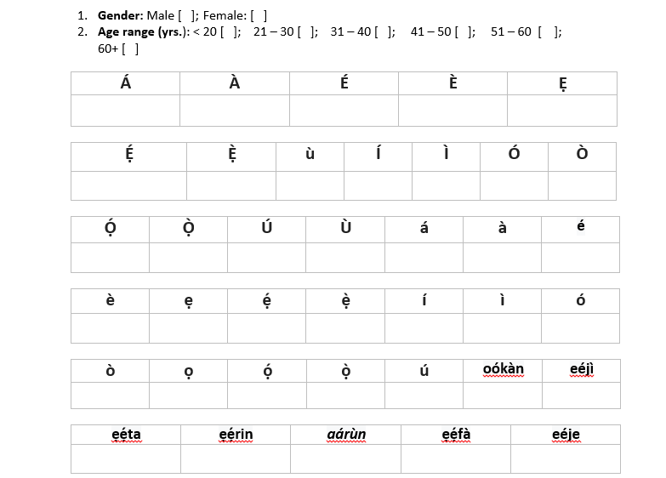
Methodology cont.
Figure 5: Design of sample form used in data collection

Slide 32
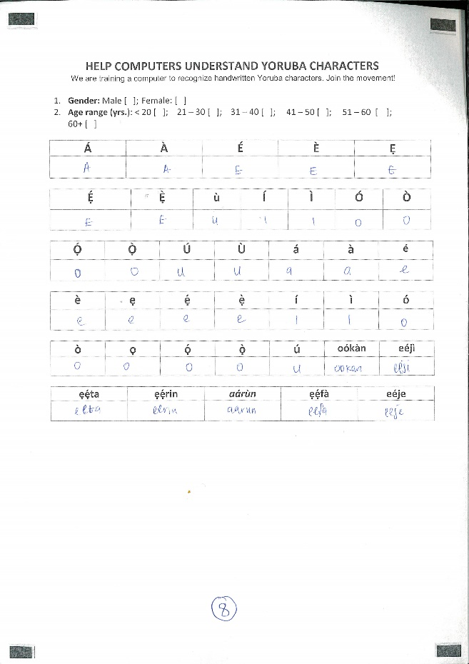
Methodology cont.
Figure 6: Sample of a filled form

Slide 33
Methodology (Objective B: Define a network architecture)
Used a pre-trained network model: GoogLenet (Szegedy et al., 2015) - integration of an Inception Module that drastically reduces the number of parameters in the network.
Activation function: Rectified Linear Units f(x) = max(0, x)
Infrastructure: Amazon Web Services (AWS) EC2 instance

Slide 34
Methodology cont.
AWS EC2 INSTANCE
High-Frequency Intel Xeon E5-2670 (Sandy Bridge) Processors.
High-performance GPUs from NVIDIA, where each has 1,536 CUDA cores and video memory of 4GB.
8 cores CPU, 15GB memory and storage of up to 60 GB
1 Graphics Processing Unit (GPU) – 4GB. Linux OS (Ubuntu 14.04).

Slide 35
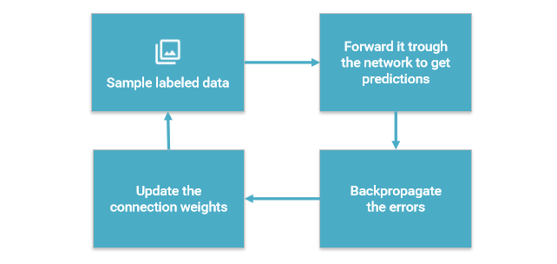
Methodology (Objective C: Train the neural network)
Learns by generating an error signal that measures the difference between the predictions of the network and the desired values and then using this error signal to change the weights so that predictions get more accurate (Back propagation).
Figure 7: Training in a neural network
Source: http://www.slideshare.net/LuMa921/deep-learning-the-past-present-and-future-of-artificial-intelligence

Slide 36
Methodology (Objective D: Evaluate the network’s accuracy)
Used the validation set to produce the recognition rates on the network.
One sample each from the 38 classes was used to validate the network.

Slide 37
Results

Slide 38
Yoruba Handwriting database
A total of 183 writers made up the database
Age range | Persons | Percentage
< 20 | 64 | 34.97%
21 - 30 | 68 | 37.16%
31 - 40 | 2 | 1.09%
> 40 | 1 | 0.55%
Uncategorized | 48 | 24.59%
Table 2: Database writers statistics

Slide 39
Yoruba Handwriting database cont.
A total of 183 writers developed a total of 6954 Yoruba characters with ground truth.
Figure 8: Graph showing age distribution
Figure 9: Gender distribution of writers

Slide 40
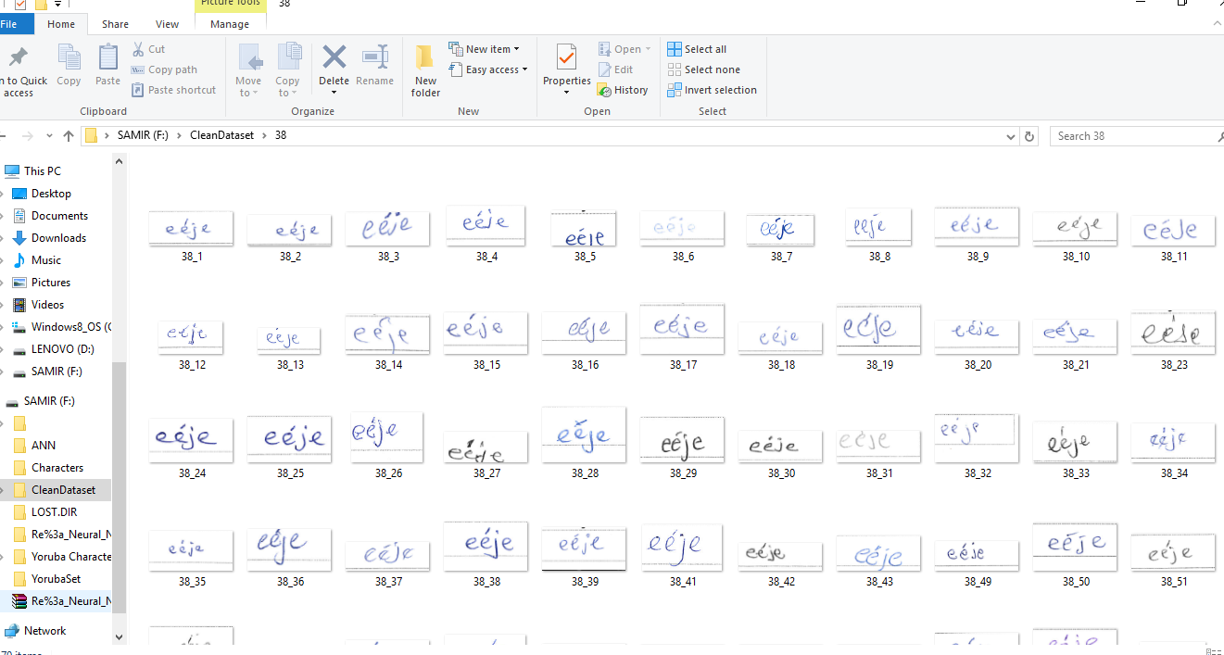
Results cont.
Figure 10: Data set of the character eéje

Slide 41
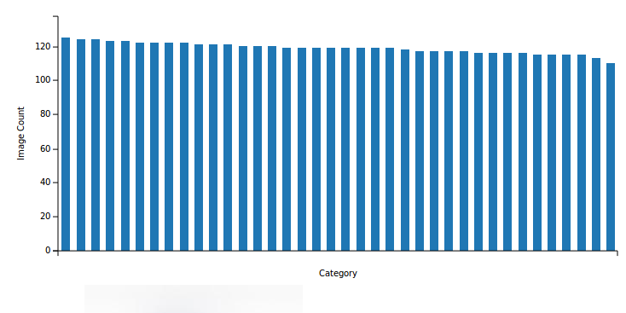
Results cont.
Figure 11: Data set statistics used for the training process.

Slide 42
Network Training
The process starts at a base learning rate of 0.001 with low-accuracy values.
As the process continues, this weights continuously adjusts and the network’s accuracy continues to improve steadily. Meanwhile, the train loss, as well as the validation loss, steadily decline.
After 30 epochs, we get accuracies near 100%.

Slide 43
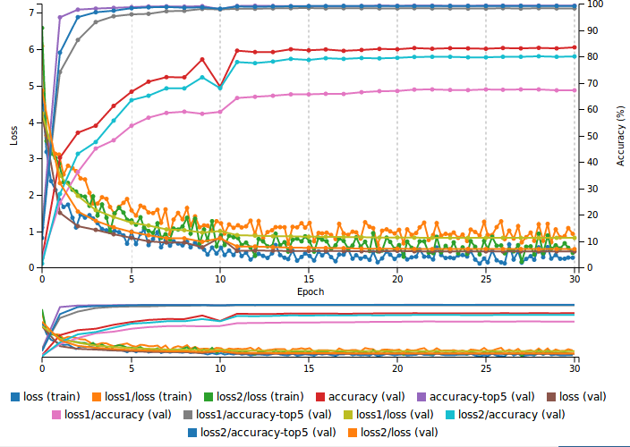
Network Training cont.
Figure 12: Graph showing loss, accuracy train and values

Slide 44
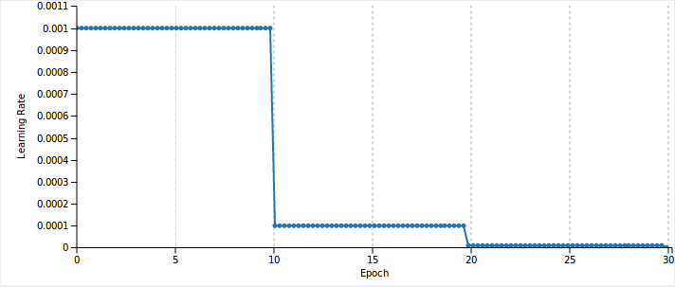
Results cont.
Learning rate starts initially at 0.001, then changes to 0.0001 at 10 epochs and near 0.00 at 20 epochs till the training completes at 30 epochs.
Figure 13: Graph showing learning rate change during training

Slide 45
Validation Results
The evaluation of the network was done using images the network had not seen before in order to classify the images into the different classes

Slide 46
Validation Results cont.
Character | Recognition rates
Á | 92.42%
Ì | 59.69%
Ó | 71.16% (LC – 21.12%)
Ọ́ | 97.03%
Ọ́ | 73.36% (LC - 26.31%)
è, ẹ | 99%
é, À | 99%
Table 2: Sample validation numbers

Slide 47
Validation results cont.
Character | Recognition rates
ẹ́ | 99.92%
ẹ̀ | 96.03%
ì | 92.81% (UC – 6.48%)
Ó | 55.37% (UC – 41.59%)
É | 88.53% (LC – 9.35%)
ọ | 99.72%
ú | 95.94%
Table 2: Sample validation numbers

Slide 48
Validation Results cont.
Character | Recognition rates
eéjì | 99.9%
ẹẹ́rin | 99.81%
ẹẹ́fà | 97.64%
oókàn | 100%
ẹẹ́ta | 100%
eéje | 100%
Table 2: Sample validation numbers

Slide 49
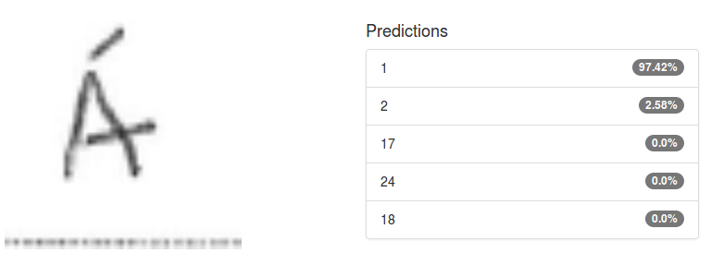
Validation Results cont.
Figure 14: Validation sample of a single character

Slide 50
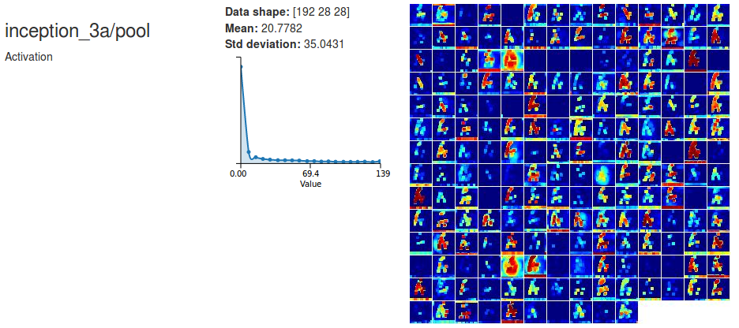
Validation Results cont.
Figure 15: Visualization on the inception layer for the character Á

Slide 51
99 - 100% recognition rates

Slide 52
Significance of the study

Slide 53
Significance of study
With this research work, we have:
Opened up a new world for local technology.
Facilitated personalized experience for locals and better understanding of digital content.

Slide 54
Contribution to knowledge

Slide 55
Contribution to knowledge
Creation of a publicly available dataset for Yoruba handwritten characters.
Convolutional neural network model to identify handwritten Yoruba characters.

Slide 56
Scope of the study
This work is limited to offline character recognition as it leaves out online input sources for recognition.

Slide 57
Conclusion
By using deep learning, we have been able to provide state-of-the-art results in Yoruba handwritten recognition with rates of 99% on the novel dataset also presented in this work.
Contributions to the global deep learning revolution have also begun from Nigeria.

Slide 58
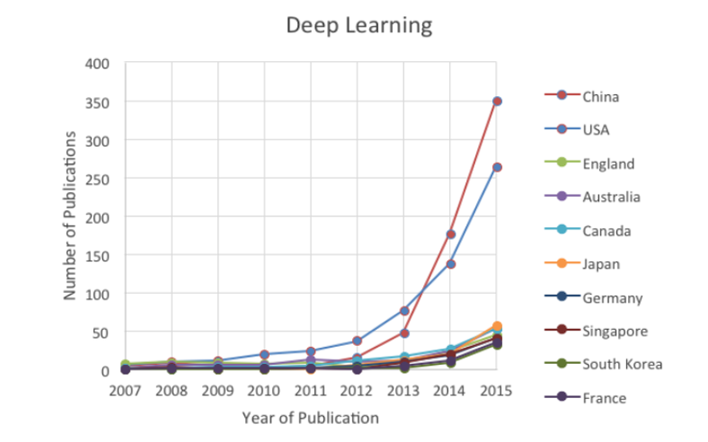
Figure 16: Trends for Machine learning and deep learning
Source: Bloomberg

Slide 59
References
Abadi, M., Agarwal, A., Barham, P., Brevdo, E., Chen, Z., Citro, C., ... & Ghemawat, S. (2016). Tensorflow: Large-scale machine learning on heterogeneous distributed systems. arXiv preprint arXiv:1603.04467.
Ajao, J. F., Olabiyisi, S. O., Omidiora, E. O., & Odejobi, O. O. Yoruba Handwriting Word Recognition Quality Evaluation of Preprocessing Attributes using Information Theory Approach.
Anil, R., Manjusha, K., Sachin Kumar, S., & Soman, K. P. (2015). Convolutional neural networks for the recognition of malayalam characters. Advances in Intelligent Systems and Computing. https://doi.org/10.1007/978-3-319-12012-6_54
Golovko, V., Egor, M., Brich, A., & Sachenko, A. (2017). A shallow convolutional neural network for accurate handwritten digits classification. Communications in Computer and Information Science. https://doi.org/10.1007/978-3-319-54220-1_8
Jia, Y., Shelhamer, E., Donahue, J., Karayev, S., Long, J., Girshick, R., ... & Darrell, T. (2014, November). Caffe: Convolutional architecture for fast feature embedding. In Proceedings of the 22nd ACM international conference on Multimedia (pp. 675-678). ACM. Chicago
Liu, C. L., Yin, F., Wang, D. H., & Wang, Q. F. (2013). Online and offline handwritten Chinese character recognition: benchmarking on new databases. Pattern Recognition, 46(1), 155-162.

Slide 60
References
Oyedotun, O. K., Olaniyi, E. O., & Khashman, A. (2015). Deep learning in character recognition considering pattern invariance constraints. International Journal of Intelligent Systems and Applications, 7(7), 1.
Oyedotun, O. K., & Dimililer, K. (2016). Pattern recognition: invariance learning in convolutional auto encoder network. International Journal of Image, Graphics and Signal Processing, 8(3), 19
Patil, V., & Shimpi, S. (2011). Handwritten English character recognition using neural network. Elixir Comput Sci Eng, 41, 5587-5591.
Raina, R., Madhavan, A., & Ng, A. Y. (2009, June). Large-scale deep unsupervised learning using graphics processors. In Proceedings of the 26th annual international conference on machine learning (pp. 873-880). ACM.
Sermanet, P., Chintala, S., & LeCun, Y. (2012, November). Convolutional neural networks applied to house numbers digit classification. In Pattern Recognition (ICPR), 2012 21st International Conference on (pp. 3288-3291). IEEE.
Szegedy, C., Liu, W., Jia, Y., Sermanet, P., Reed, S., Anguelov, D., … Rabinovich, A. (2015). Going deeper with convolutions. In Proceedings of the IEEE Conference on Computer Vision and Pattern Recognition (pp. 1–9).

Slide 61
References
Szegedy, C., Ioffe, S., Vanhoucke, V., & Alemi, A. (2016). Inception-v4, inception-resnet and the impact of residual connections on learning. arXiv preprint arXiv:1602.07261.
Weyand, T., Kostrikov, I., & Philbin, J. (2016). Planet-photo geolocation with convolutional neural networks. arXiv preprint arXiv:1602.05314.
Wang, T., Wu, D. J., Coates, A., & Ng, A. Y. (2012, November). End-to-end text recognition with convolutional neural networks. In Pattern Recognition (ICPR), 2012 21st International Conference on (pp. 3304-3308). IEEE.
Wang, H., Raj, B., & Xing, E. P. (2017). On the Origin of Deep Learning. arXiv Preprint arXiv:1702.07800.
Yuan, A., Bai, G., Jiao, L., & Liu, Y. (2012). Offline handwritten English character recognition based on convolutional neural network. In Proceedings - 10th IAPR International Workshop on Document Analysis Systems, DAS 2012 (pp. 125–129). https://doi.org/10.1109/DAS.2012.61

Slide 62
Acknowledgments
I wish to express my sincere gratitude to God who by Inspiration gave me this topic.
I sincerely thank Professor Sanjay Misra for the guidance and encouragement in carrying out the research work as well as Mr Wole Adewunmi and Miss Olaperi Sowunmi for the helps.
I wish to express my gratitude to Dr. (Mrs) Oladipupo and the PG co-ordinator Dr Oyelade as well as the management of Covenant University for this platform to share ideas and push humanity forward.
And to my family, friends and everyone present here today.

